Slide 1
Identity & Access Management(IAM)

Slide 2
What is IAM
AWS Identity and Access Management (IAM) is a web service that helps you securely control access to AWS resources for your users.
You can use IAM to control who can use your AWS resources (authentication) and what resources they can use and in what ways (authorization).
It works on the below principles
CIA (Confidentiality , Integrity and Availability),
AAA (Authentication , Authorization & Availability)
RBAC (Role Based Access Control)
Least Privilege Access

Slide 3
IAM Features
Shared access to AWS account
Granular permissions
Secure access to AWS resources
Multi-factor authentication (MFA)
Identity federation
Identity information for assurance
Eventually Consistent
Free to Use

Slide 4
AWS IAM: Identities
User
Group
Roles

Slide 5
AWS IAM: User Types
Root User
When you create an AWS account, you create an AWS account root user identity—that is, the email.
When you use your root user credentials, you have complete, unrestricted access to all resources in your AWS account.
IAM User
IAM users are not separate accounts; they are users within your account.
Each user can have its own password for access to the AWS Management Console.
An IAM user doesn't have to represent an actual person; you can create an IAM user in order to generate an access key for an application.
Federating Existing Users
If your users already have a way to be authenticated—for example, by signing in to your corporate network—you can federate those user identities into AWS.

Slide 6
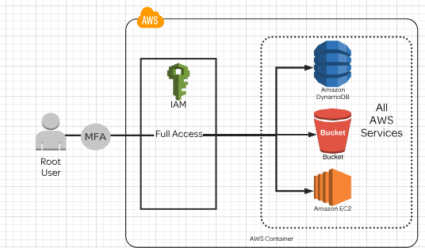
Root User

Slide 7
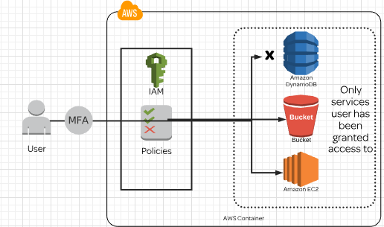
IAM USER

Slide 8
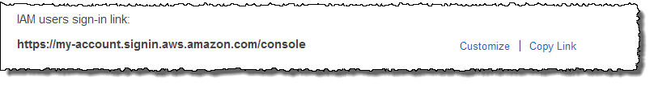
AWS IAM: How IAM User Sign-in to Account
By default, the sign-in URL for your account includes your account ID.
You can create a unique sign-in URL for your account so that the URL includes a name instead of an account ID
The sign-in endpoint follows this pattern:
https://alias.signin.aws.amazon.com/console
IAM users in your account have access only to the authorised AWS resources

Slide 9
AWS IAM:Group
Allows for policy assignment to multiple users at once
More efficient way to manage users and policies
Best Practices:
Organize users by functions
Assign policies to the group , not individual users

Slide 10
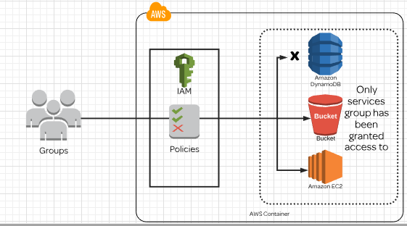
Groups

Slide 11
AWS IAM: Password Policy
Minimum password length
Require at least one uppercase letter
Require at least one lowercase letter
Require at least one nonalphanumeric character
Allow users to change their own password
Enable password expiration
Prevent password reuse
Password expiration requires administrator reset

Slide 12
AWS IAM: Permissions
Permissions let you specify who has access to AWS resources, and what actions they can perform on those resources.
Permissions are granted through policies that are created and then attached to users, groups, or roles.
By default, IAM users can't access anything in your account. You grant permissions to a user by creating a policy.
Users in your account have multiple policies that together represent the permissions for that user.
When you give permissions to a group, all users in that group get those permissions.
To assign permissions to federated users, you can create an entity referred to as a role and deﬁne permissions for the role.

Slide 13
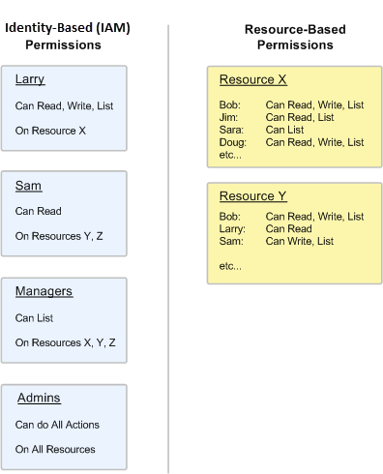
AWS IAM: Permission Types
Resource-based permissions and resource-level permissions.
Resource-based permissions are permissions you can attach directly to a resource.
Resource-level permissions refers to what actions users can perform, and what they allowed to perform

Slide 14
AWS IAM: Policies Structure
Each policy is a JSON document.
A policy is a document that formally states one or more permissions.
The policy document includes the following elements:
Effect
Action
Resource
Condition (Optional)
{
"Version": "2012-10-17",
"Statement": [
{
"Sid": "FirstStatement",
"Effect": "Allow",
"Action": ["iam:ChangePassword"],
"Resource": "*"
},
{
"Sid": "SecondStatement",
"Effect": "Allow",
"Action": "s3:ListAllMyBuckets",
"Resource": "*"
},
{
"Sid": "ThirdStatement",
"Effect": "Allow",
"Action": [
"s3:List*",
"s3:Get*"
],
"Resource": [
"arn:aws:s3:::confidential-data",
"arn:aws:s3:::confidential-data/*"
],
"Condition": {"Bool": {"aws:MultiFactorAuthPresent": "true"}}
}
]
}

Slide 15
AWS IAM: User Based Policies
Attach this policy to an IAM user or group.
User or group is allowed to perform only this one action (ListBucket) on one Amazon S3 bucket (example_bucket).
{
"Version": "2012-10-17",
"Statement": {
"Effect": "Allow",
"Action": "s3:ListBucket",
"Resource": "arn:aws:s3:::example_bucket"
}
}

Slide 16
AWS IAM: Resource Based Policy
A resource-based policy contains slightly diﬀerent information than a user-based policy.
In a resource-based policy you specify what actions are permitted and what resource is aﬀected (just like a user-based policy).
However, you also explicitly list who is allowed access to the resource. (In a user-based policy, the "who" is established by whomever the policy is attached to.)
Resource-based policies include a Principal element that speciﬁes who is granted the permissions.
{
"Version": "2012-10-17",
"Statement": {
"Effect": "Allow",
"Principal": {"AWS": "arn:aws:iam::777788889999:user/bob"},
"Action": [
"s3:PutObject", “
s3:PutObjectAcl"
],
"Resource": "arn:aws:s3:::example-bucket/*"
}
}

Slide 17
AWS IAM: Resource Based Permission
For resource-based permissions, attach a policy to the resource, such as an S3 Bucket.
Include, who is allowed to access the resource, known as the Principal.
This Policy attached to an Amazon S3 bucket and grants permission to a speciﬁc AWS account to perform any Amazon S3 actions in mybucket.
This includes both working with the bucket and with the objects in it.
{
"Version": "2012-10-17",
"Id": "S3-Account-Permissions",
"Statement": [{
"Sid": "1",
"Effect": "Allow",
"Principal": {"AWS": ["arn:aws:iam::ACCOUNT-ID-WITHOUT-HYPHENS:root"]},
"Action": "s3:*",
"Resource": [
"arn:aws:s3:::mybucket",
"arn:aws:s3:::mybucket/*"
]
}]
}

Slide 18
AWS IAM: Policies Types
AWS Managed
Service Based Policies
AWS Managed
Job Based Policies
Customer Managed Policies

Slide 19
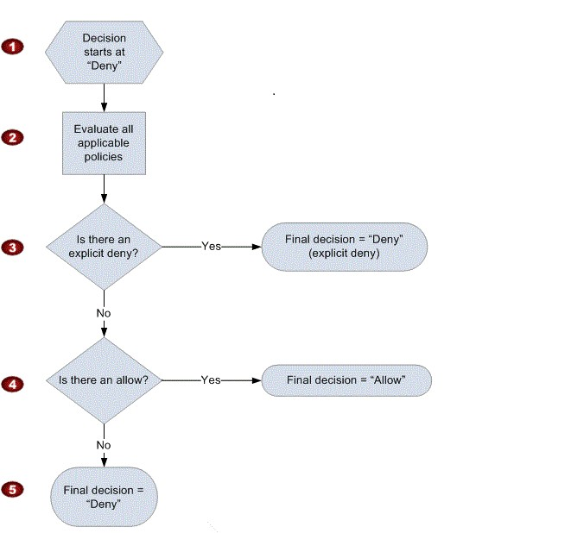
AWS IAM: Request Flow
When a request is made, the AWS service decides whether a given request should be allowed or denied.
The evaluation logic follows these rules:
By default, all requests are denied.
An explicit allow overrides this default.
An explicit deny overrides any allows.

Slide 20
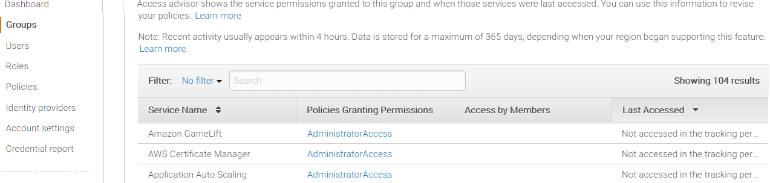
Access Advisor
Users should have few permissions as much possible (Least Privilege)
Access Advisor is for auditing permissions , unused permissions to be identified.
Can be used for Users, Groups and Roles

Slide 21
IAM Roles
IAM roles are a secure way to grant permissions to entities that you trust.
Examples of entities include the following:
IAM user in another account
Application code running on an EC2 instance that needs to perform actions on AWS resources
An AWS service that needs to act on resources in your account to provide its features
Users from a corporate directory who use identity federation with SAML
IAM roles issue keys that are valid for short durations, making them a more secure way to grant access.

Slide 22
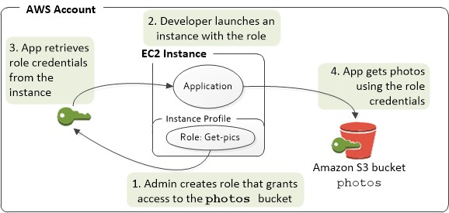
AWS IAM: IAM Role to EC2 Instance
Use an IAM role to manage temporary credentials for applications that run on an EC2 instance
The role supplies temporary permissions that applications can use when they make calls to other AWS resources

Slide 23
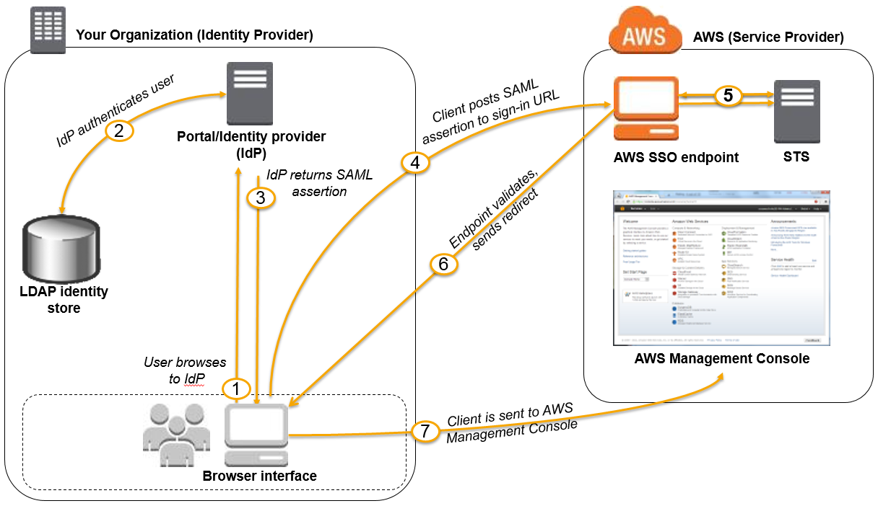
Identity Federation
Federation : Provide a non-AWS user temporary AWS access by linking that user ‘s identity across multiple identity systems.
Federation with Third Party Providers:
Used in Web and Mobile Applications
AWS Cognito allows for
- Creation of unique identities for users
- Use Identity Providers to federate
Example Providers : Facebook , Google , Amazon etc..

Slide 24
Establishing SSO
Using SAML 2.0
Used in enterprise environments with and existing directory system – Active Directory, LDAP etc.
Federated Users can access AWS resources using their corporate domain accounts
Also helps user management by allowing central management of accounts
Without SAML
AWS Directory Service for Microsoft Directory
Allows for Windows Trust Relationship to be built between On-Premises AD and AWS Microsoft AD in the cloud.

Slide 25
Security Token Service
Allows for management of temporary security credentials
Allows for granular control of how long the access must be active.Default is 1 hr
Credentials are not stored with the user , rather token is provided for every access request
Uses a single endpoint - https://sts.amazonaws.com
- Resides in us-east-1(North Virginia)

Slide 26
Thank You

